Slide 1
SAIGE 12TH ANNUAL NATIONAL TRAINING PROGRAM
GROWING NATIVE LEADERS:
ENHANCING OUR SEVEN GENERATIONS

Slide 2
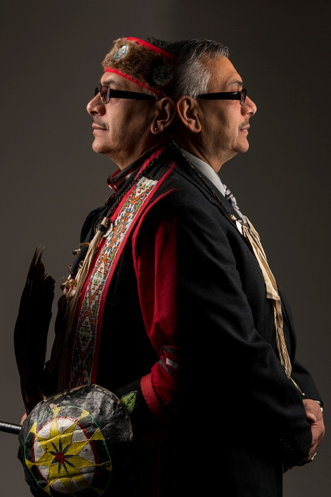
SAIGE 12TH ANNUAL NATIONAL TRAINING PROGRAM GROWING NATIVE LEADERS: ENHANCING OUR SEVEN GENERATIONS
COLORING OUTSIDE THE LINES:
GUYAUSHK JAMES E. PETE, DBA
SEAGULL
WALKING IN TWO WORLDS

Slide 3
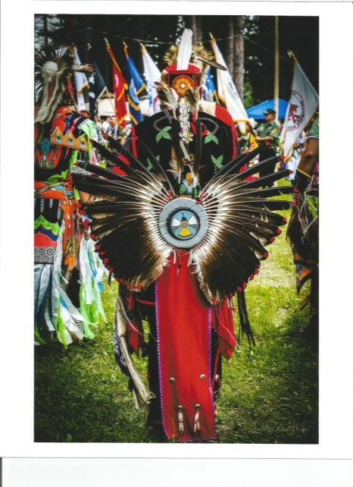
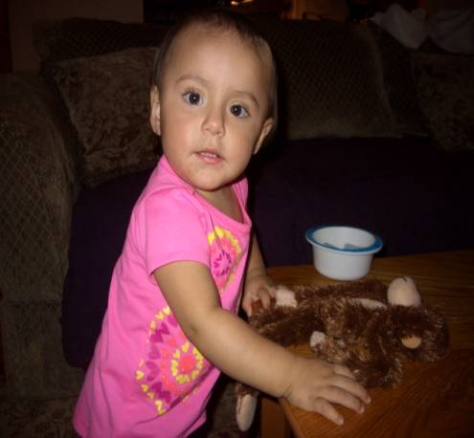
SAIGE 12TH ANNUAL NATIONAL TRAINING PROGRAM GROWING NATIVE LEADERS: ENHANCING OUR SEVEN GENERATIONS
LAYING THE FOUNDTION
FOR
TODAY….
TOMORROW….
THE NEXT 7 GENERATIONS….
WITH ACKNOWLEDGING
THE PAST

Slide 4
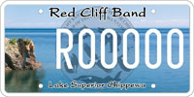
SAIGE 12TH ANNUAL NATIONAL TRAINING PROGRAM GROWING NATIVE LEADERS: ENHANCING OUR SEVEN GENERATIONS
KEY WORDS TO KNOW!
CULTURE/TRADITION – LEGAL
MULTI-GENERATIONAL TRAUMA MULTI-HISTORICAL TRAUMA
SOVEREIGNTY
SELF-DETERMINATION SELF-GOVERNANCE
TRUST RESPONSIBILITY

Slide 5
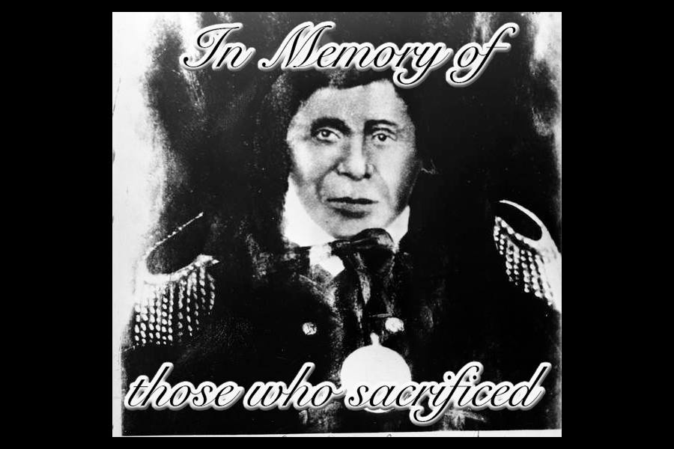
SAIGE 12TH ANNUAL NATIONAL TRAINING PROGRAM GROWING NATIVE LEADERS: ENHANCING OUR SEVEN GENERATIONS
CHIEF BUFFALO

Slide 6
SAIGE 12TH ANNUAL NATIONAL TRAINING PROGRAM GROWING NATIVE LEADERS: ENHANCING OUR SEVEN GENERATIONS
7 TRADITIONAL ANISHINAABE TEACHINGS
NIBWAAKAAWIN WISDOM: WE SEEK TO LEARN
ZAAGI’IDIWIN LOVE: LOVE FOR EACH OTHER AND OURSELVES IN EVERYTHING WE DO
MAANAAJI’IDIWIN RESPECT: EVERYTHING HAS A SPIRIT AND THEREFORE DESERVES RESPECT
ZOOGIDE’EWIN COURAGE: WHEN WE HAVE A STRONG HEART, WE ARE ABLE TO FACE CHALLENGES WITH COURAGE AND INTEGRITY
GWAYAKWAADIZIWIN HONESTY: TO DO WHAT IS RIGHT
DABASENIMOWIN HUMILITY: TO UNDERDSTAND WE ARE HUMBLE BEINGS
DEBWEWIN TRUTH: EACH OF US HOLDS THE TRUTH IN OUR HEART

Slide 7
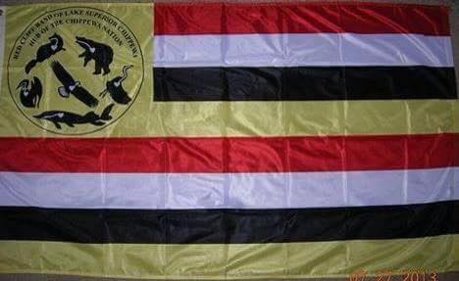
SAIGE 12TH ANNUAL NATIONAL TRAINING PROGRAM GROWING NATIVE LEADERS: ENHANCING OUR SEVEN GENERATIONS
RED CLIFF TRIBAL FLAG
As with many Tribal Communities/Nations, the Red Cliff Band of Lake Superior Chippewa Indians has a Tribal Flag.
Each Tribal Flag is unique and represents the local Community Culture, however, it also relates to the overall Anishinaabe Culture.
For the Red Cliff Community, one interpretation of the Tribal Flag is the significance of the colors of Red, White, Yellow, and Black. These colors may be in direct relation with the four races, the four seasons, the four directions, and the four stages of life.
In each Tribal Community/Nation, they were represented by an animal from the Clan system. This was a traditionally important aspect, as it also represented the responsibility of those individuals who followed the patrilineal Clan system of the Anishinaabe.
The animals on the Red Cliff Tribal Flag, may have the following responsibilities to fulfill:
Loon- Chief * Eagle-Spiritual * Bear-Warriors * Sturgeon-Teachers * Crane-Leaders * Martin-Hunters
The Red Cliff Tribal Flag is an important aspect of modern day living. It ties the Tribal Community back to the history, lifestyles, and promotes the teachings of traditions for the next Seven Generations of the Anishinaabeg.

Slide 8
SAIGE 12TH ANNUAL NATIONAL TRAINING PROGRAM GROWING NATIVE LEADERS: ENHANCING OUR SEVEN GENERATIONS
OGIMAAWAADIZI
(HAVING LEADERSHIP QUALITIES)
BEING IN BALANCE THROUGH WELLNESS AND SPIRITUALITY
~FOLLOW YOUR OWN SPIRITUAL PATH
~PROMOTION OF WELLNESS AND BALANCE
~BELIEVE STRONGLY IN WHAT YOU BELIEVE
~HAVE AN OPEN HEART, MIND, BODY, AND SOUL…
~GOING HOME AFTER A MEETING, FEELING GOOD, AND KNOWING YOU MADE THE BEST DECISION(S) YOU
COULD

Slide 9
SAIGE 12TH ANNUAL NATIONAL TRAINING PROGRAM GROWING NATIVE LEADERS: ENHANCING OUR SEVEN GENERATIONS
OGIMAAWAADIZI
(HAVING LEADERSHIP QUALITIES)
LEARNING FROM OUR ANCESTORS, ELDERS, AND THE IMPORTANCE OF VALUES
~ELDERS
~ RESPECT – BEING RESPECTFUL – HONOR
~STRENGTH COMES FROM THE PEOPLE
~BEING ON EQUAL GROUND WITH ALL PEOPLE
~GIVE ONE’S WORD
~HUMBLE
~LEAD BY EXAMPLE
~ LISTEN – HEAR
~ACKNOWLEDGE OTHER’S THOUGHTS AND OPINIONS

Slide 10
SAIGE 12TH ANNUAL NATIONAL TRAINING PROGRAM GROWING NATIVE LEADERS: ENHANCING OUR SEVEN GENERATIONS
OGIMAAWAADIZI
(HAVING LEADERSHIP QUALITIES)
UNDERSTANDING OGIMAAWAADIZI (LEADERSHIP QUALITIES)
~LONG-TERM APPROACH TO SURVIVAL
~DEFINE WHAT SOVEREIGN MEANS TO US
~LEADERSHIP DISTRIBUTED
~RESOLVING CONFLICT – RESTITUTION
~A LEADER MAKES A PATH – AND IS OPEN TO FOLLOWING
~DECISION MAKING – BE PATIENT – CONSIDER ALL EFFECTS – CONSENSUS

Slide 11
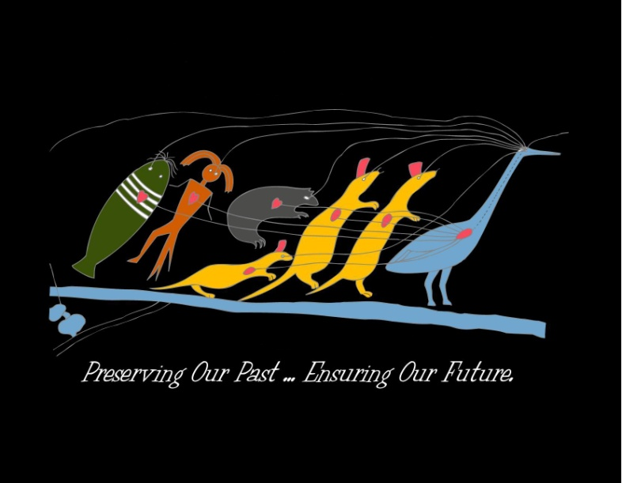
SAIGE 12TH ANNUAL NATIONAL TRAINING PROGRAM GROWING NATIVE LEADERS: ENHANCING OUR SEVEN GENERATIONS
LEADERSHIP/CHIEF(S) CLAN: CRANE AJIJAAK
The crane was considered the most eminent and was selected to symbolize leadership and direction. As the crane calls and
commands attention, so ought to a leader that would bear the same attention in the discharge of his duties. The Crane was
a leader and the first of speakers.

Slide 12
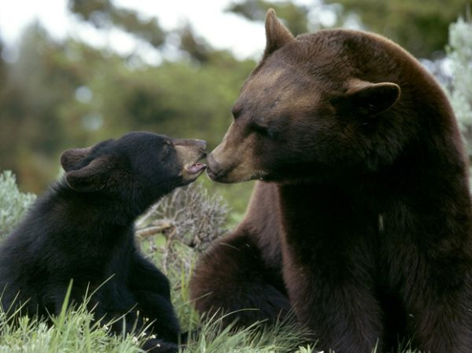
SAIGE 12TH ANNUAL NATIONAL TRAINING PROGRAM GROWING NATIVE LEADERS: ENHANCING OUR SEVEN GENERATIONS
DEFENSE/WARRIORS CLAN: BEAR MAKWA
Being a warrior was considered an honor and was a test for heart, strength, and skill. Many of the warriors were the youth of the
Tribe and at times were called upon to defend family and community from attacks. To the individual, a fight was not a war; it was
a chance to prove one’s worth.

Slide 13
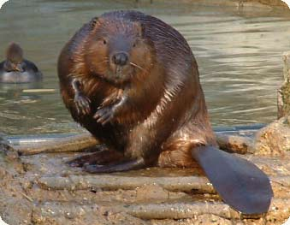
SAIGE 12TH ANNUAL NATIONAL TRAINING PROGRAM GROWING NATIVE LEADERS: ENHANCING OUR SEVEN GENERATIONS
SUSTENANCE/HUNTERS CLAN: BEAVER AMIK
This was considered one of the highest respected roles in the Tribal community. The responsibility to provide food,
materials for clothing, and shelter was vested in the hunters. Hunting demanded skill in tracking down game, patience to
wait long periods of time, and the ability to judge distances when utilizing the bow and arrow. Those individuals who were
considered hunters also had to be aware of the weather and other elements that could dramatically affect their efforts to
provide food.

Slide 14
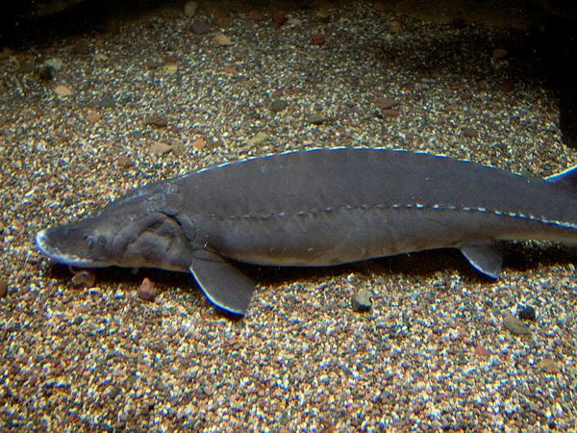
SAIGE 12TH ANNUAL NATIONAL TRAINING PROGRAM GROWING NATIVE LEADERS: ENHANCING OUR SEVEN GENERATIONS
LEARNING/TEACHERS CLAN: STURGEON NAME (NA-MAY)
It was the elders, the grandmothers and grandfathers who taught about life through stories parables, fables, songs, chants,
and dances. They were the ones who lived long enough to gain knowledge about life and paths to follow. The qualities they
possessed were wisdom, knowledge, patience, and generosity.

Slide 15
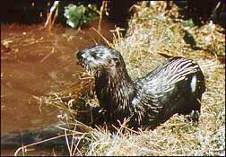
SAIGE 12TH ANNUAL NATIONAL TRAINING PROGRAM GROWING NATIVE LEADERS: ENHANCING OUR SEVEN GENERATIONS
MEDICINE/HEALERS CLAN: OTTER NIGIG
Once a person was chosen as a healer, they went through a long process through an apprenticeship with a medicine
man/women. The training was designed to include the study of plants, utilization of spirituality in the Creator, and
gaining an understanding of the person. The power of dreams was important to understand and interpret.

Slide 16
SAIGE 12TH ANNUAL NATIONAL TRAINING PROGRAM GROWING NATIVE LEADERS: ENHANCING OUR SEVEN GENERATIONS
SWOT ANALYSIS
A SWOT analysis may be incorporated into the PLANNING
STRENGTHS Factors helpful to achieving objectives
WEAKNESSES Factors harmful to achieving objectives
OPPORTUNITIES Factors helpful to achieving objectives
THREATS Factors which could do damage
INTERNAL FACTORS IN THE USE OF THE SWOT ANALYSIS
Internal factors – strengths and weaknesses
EXTERNAL FACTORS IN THE USE OF THE SWOT ANALYSIS
External factors – The opportunities and threats presented by the external environment

Slide 17
SAIGE 12TH ANNUAL NATIONAL TRAINING PROGRAM GROWING NATIVE LEADERS: ENHANCING OUR SEVEN GENERATIONS
SWOT ANALYSIS
STRENGTHS WEAKNESSES
OPPORTUNITIES THREATS

Slide 18
SAIGE 12TH ANNUAL NATIONAL TRAINING PROGRAM GROWING NATIVE LEADERS: ENHANCING OUR SEVEN GENERATIONS
SEVENTH GENERATIONAL PHILOSOPHY
In many Tribal Communities, people thought of the impact of the decisions they made for the day and how it would affect
The next Seven Generations. I would encourage and advocate, to consider these 7th Generational Philosophies:
WITHIN 7 DAYS Meet with Tribal Community members
Meet with Tribal Council members
Meet with Tribal Staff
WITHIN 7 WEEKS Sponsor two all Tribal staff gatherings
Hold 1 Tribal Community Gathering – beginning long-term planning process
Sponsor a Tribal Business summit (Tribal Businesses and Individuals)
WITHIN 7 MONTHS Hold two additional Tribal Community Gatherings
Sponsor Tribal Education Summit
Hold two additional Tribal Planning sessions
WITHIN 7 YEARS Continuous interaction with Tribal Community in planning efforts

Slide 19
SAIGE 12TH ANNUAL NATIONAL TRAINING PROGRAM GROWING NATIVE LEADERS: ENHANCING OUR SEVEN GENERATIONS
LOOKING TO THE FUTURE
Please list three to five areas you will concentrate on for the next 7 (days, weeks, months, years):
1.
2.
3.
4.
5.

Slide 20
SAIGE 12TH ANNUAL NATIONAL TRAINING PROGRAM GROWING NATIVE LEADERS: ENHANCING OUR SEVEN GENERATIONS
GUYAUSHK’S (JIM PETE’S) PERSONAL PHILOSOPHIES
“ENCOURAGING TRIBAL INVOLVEMENT IN OUR COMMUNITY”
TRADITIONAL
Rises up to heights, swoops down on the water, and looks in search of the Land
MANAGEMENT
Participative management by encouraging the concept of “WE” through responsibility, dedication, and delegation
SPIRITUALITY/SOBRIETY
Destiny in the hands of the Great Spirit
Let them..let them…for they will meet themselves…See, they have met themselves….
TRIBAL POLITICAL
Increasing Tribal involvement in our Government and Community

Slide 21
SAIGE 12TH ANNUAL NATIONAL TRAINING PROGRAM GROWING NATIVE LEADERS: ENHANCING OUR SEVEN GENERATIONS
BEING A LEADER IS LIKE MAKING CHILI….
WE ALL HAVE OUR OWN “RECIPE!”
WHAT WILL YOUR RECIPE BE?
MAKING A PERSONAL COMMITMENT

Slide 22
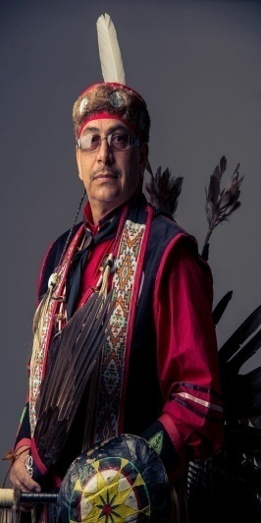
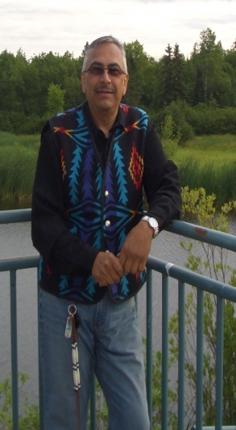
SAIGE 12TH ANNUAL NATIONAL TRAINING PROGRAM GROWING NATIVE LEADERS: ENHANCING OUR SEVEN GENERATIONS
CHI MII-GWECH!!!!
(A BIG THANK YOU)!!!!
JAMES E. PETE, DBA
TRIBAL MANAGEMENT CONSULTANT

